Slide 1
Personality Detection From Text - Final Year Project
Under the guidance and mentorship of
Sir Amitabha Acharya
Group Members
Mayukh Mitra(1851005), Pushan Pore(1851012),
Manjari Nandi Majumdar (1851039) and Srinjoy Paul (1851062)

Slide 2




Individual contributions in team work
Mayukh Mitra
1851005
SVM Approach
Document Level Feature Extraction
ML Approach
Pushan Pore
1851012
Data Cleaning
Data Filtering
Feature Extraction
Manjari Nandi Majumdar
1851039
Word vectorization
Classification
Naïve – Bayes Classifier
Srinjoy Paul
1851062
Classification
Deep Learning Approach
Accuracy Enhancement

Slide 3
Motivation
Personality is a combination of an individual’s
behavior, emotion, motivation, and thought pattern. Our personality has a great impact on our mind, our behavior our course of. Knowing one’s personality can be very helpful in order to analyze one’s mental health.
Sentiment analysis plays a key role here. This project has far reaching real world applications like:
Product Recommendations by e-stores, mental health check ups, forensic application to understand criminal psychology, to detect criminal tendency, to detect depression and suicidal tendencies.

Slide 4
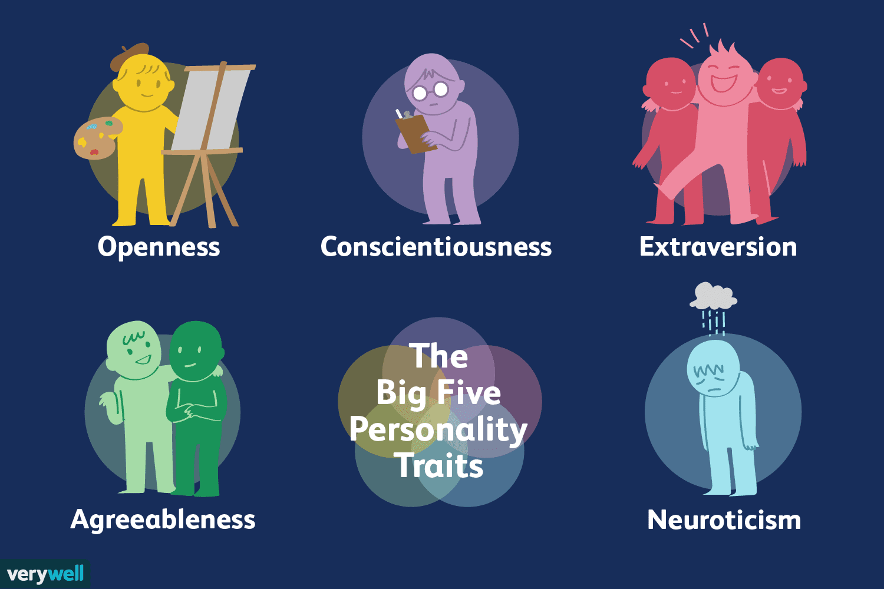
Key Concept- Five Factor Model
Personality is typically formally described in
terms of the Big Five personality traits, which are
the following binary (yes/no) values:
• Extraversion: Is the person outgoing, talkative,
and energetic versus reserved and solitary?
• Neuroticism: Is the person sensitive and
nervous versus secure and confident?
• Agreeableness: Is the person trustworthy,
straightforward, generous, and modest versus
unreliable, complicated, meager, and boastful?
• Conscientiousness: Is the person efficient and organized versus sloppy and careless?
• Openness: Is the person inventive and curious versus dogmatic and cautious?

Slide 5
Objective
In the 1970s two research teams led by Paul Costa and Robert R. McCrae of the National Institutes of Health and Warren Norman and Lewis Goldberg of the University of Michigan at Ann Arbor and the University of Oregon, respectively, discovered that most human character traits can be described using five dimensions. Surveys of thousands of people yielded these largely independent traits. The objective of this model is to detect the absence/presence of five different personality attributes based on texts gathered from various personalities.
Algorithm and Approach
We took two different approaches to implement our project, the first one is naïve based on Machine Learning and the other approach deals with Neural Networks which is based on Deep Learning.
I. Machine Learning Approach: In this approach we first clean the gathered data and store it in a dataframe, after that we remove the unwanted characters and words and pick-up the words which are then used to create the bag of words, then we convert the text in the form of vectors and then we build Bayes classifier model to train and test on our data and then finally we predict the output using the model built.
II. Deep Learning Approach: In this approach we first clean the gathered data and store it in a dataframe. We fed sentences from the essays to convolution filters to obtain the sentence. We represented each individual essay by aggregating the vectors of its sentences. We concatenated the obtained vectors with the Mairesse features,4 which were extracted from the texts directly at the preprocessing stage; this improved the method’s performance. then we merge five target attributes into a single target attribute, after that we create the deep learning model of 4 layers using ANN, then we split the data into train and test dataset. After that we measure the accuracy based on the test data of the model built.

Slide 6
Objective
III. Support Vector Machine Approach: SVM classifier separates data points using a hyperplane with the largest amount of margin. That's why an SVM classifier is also known as a discriminative classifier. SVM finds an optimal hyperplane which helps in classifying new data points. In this approach we first clean the gathered data and store it in a dataframe, after that we remove the unwanted characters and words and pick-up the words which are then used to create the bag of words, then we convert the text in the form of vectors. We then find support vectors for each personality trait. This gives us the linear discriminant function for mapping the output.

Slide 7
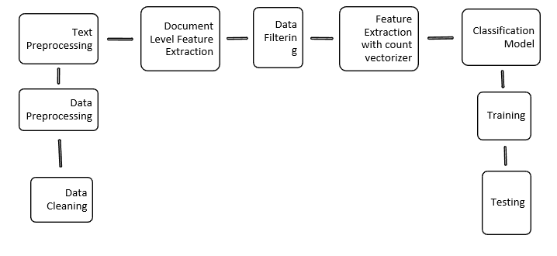
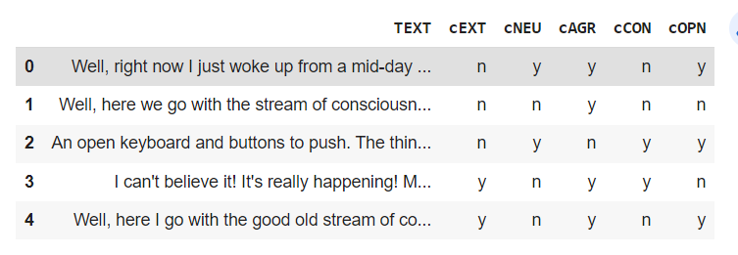
Project Overview
Data Preprocessing and Cleaning.
Text Preprocessing – coversion to lowercase, removing special characters.
Document Level Feature Extraction.
Data Filtering – removing stop words.
Feature Extraction with Count Vectorizer.
Classification Model Creation – Using both ML and Deep Learning Approach.
Training
Testing
DATASET

Slide 8
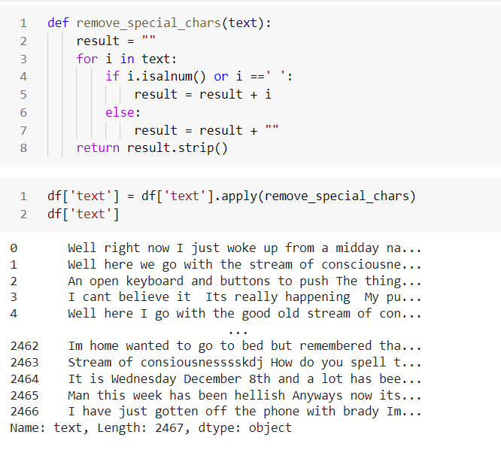
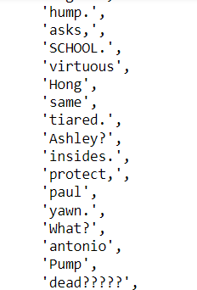
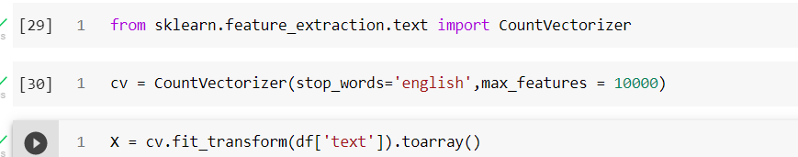
Approach 1 – Naïve Approach
Remove special characters: Making Bag of Words:
Vectorization:

Slide 9
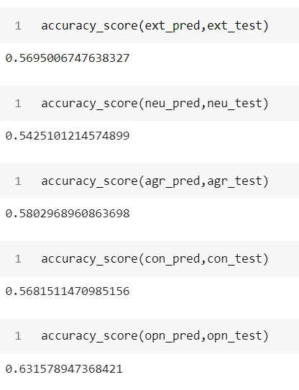
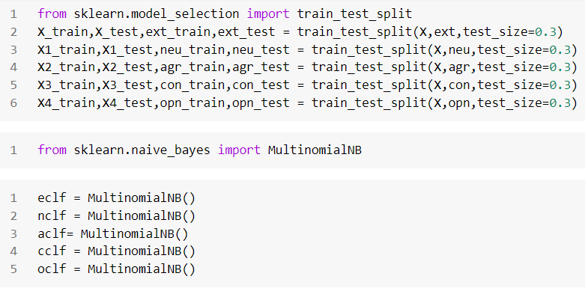
Approach 1 – Naïve Bayes
Use Multinomial Naïve Bayes Find Accuracy Score of the Model:
Classifier:
Extraversion: 0.59
Neuroticism:0.54
Agreeableness:0.58
Conscienticiousness:0.56
Openness: 0.63

Slide 10
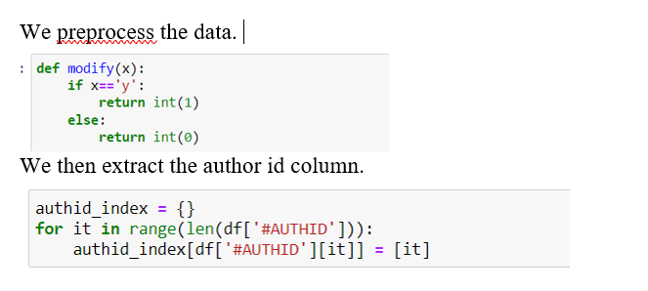
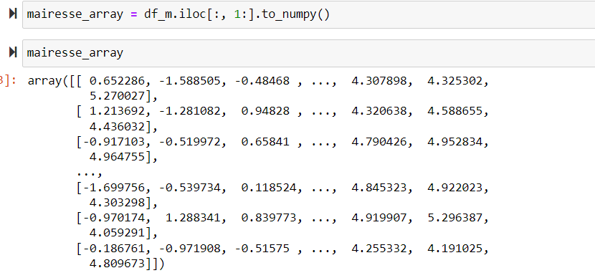
Approach 2 – Deep Learning
We used the Mairesse baseline feature set (10*85), which includes such global features as the word count and average sentence length. We append the author id with this set to uniquely identify the columns. We rename the columns for better understanding.
Next, we move on to Document Level Feature Extraction.

Slide 11
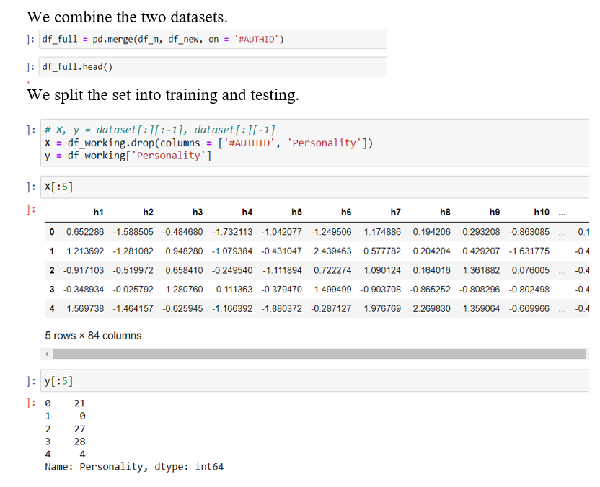
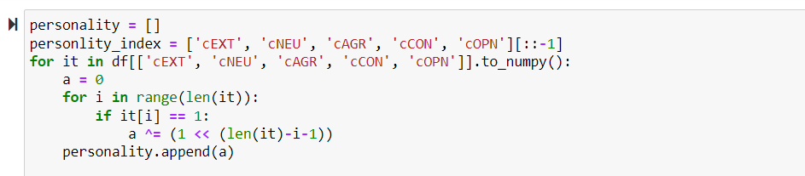
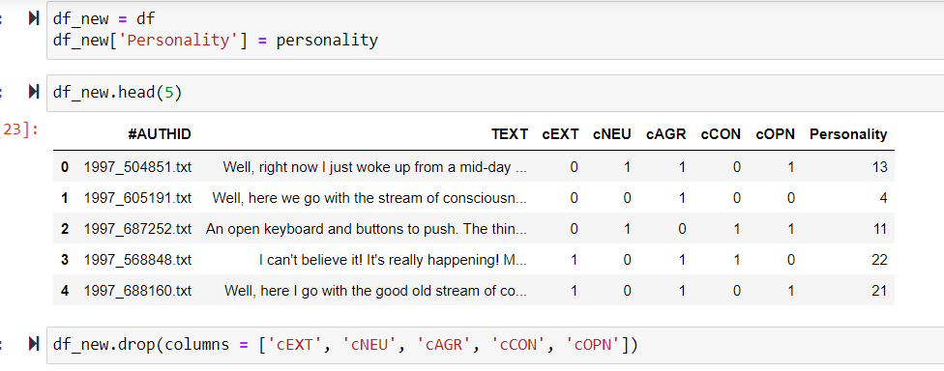
Approach 2 – Deep Learning
Converting 5 personality columns( corresponding to 5 bits) to a single column (decimal value).

Slide 12
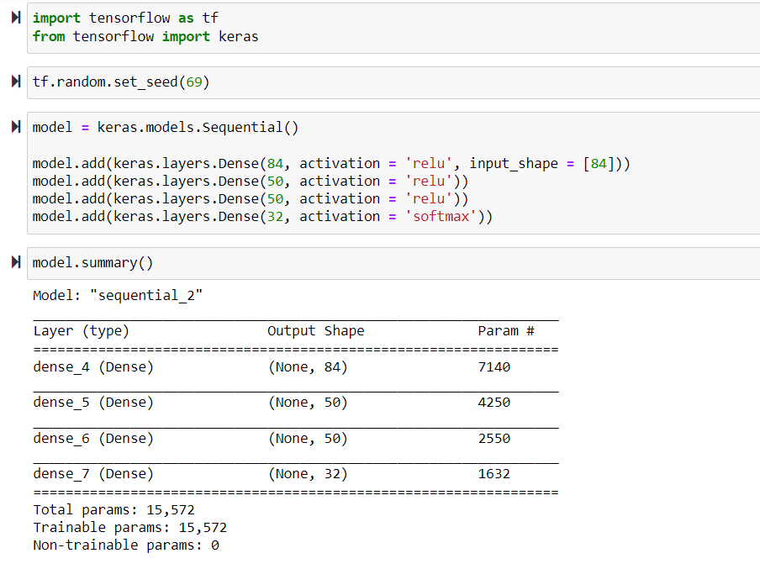
Approach 2 – Deep Learning
ANN (Artificial Neural Network) model creation.
Tensorflow and Keras are used for this model creation.
1 input layer
2 hidden layers
1 output layer
This is a 84-50-50-32 network.

Slide 13
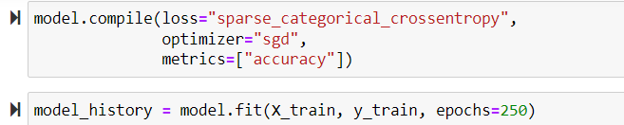
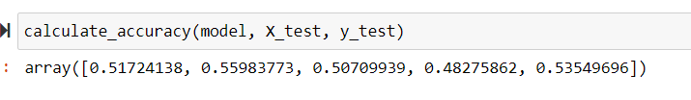
Approach 2 – Deep Learning
We are training the model and measuring its accuracy and loss function.

Slide 14
Approach 3 – SVM
Approach
Remove special characters: Making Bag of Words:
Vectorization:

Slide 15
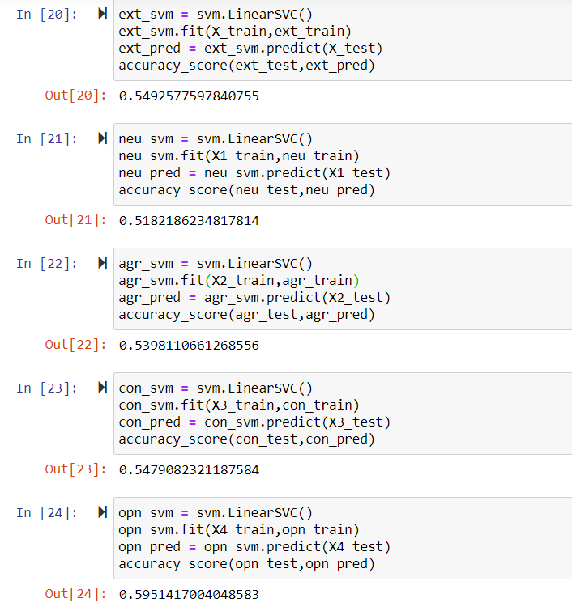
Approach 3 – SVM
We finally make five SVM Classifiers.
We then fit the model and predict the test set.
We finally find the accuracy scores.
SVM has the simplicity of basic classifiers as well as it is able to handle complex inputs like neural network.
Even though we expected to see, certain improvements in accuracy, we see that those are nearly the same.

Slide 16
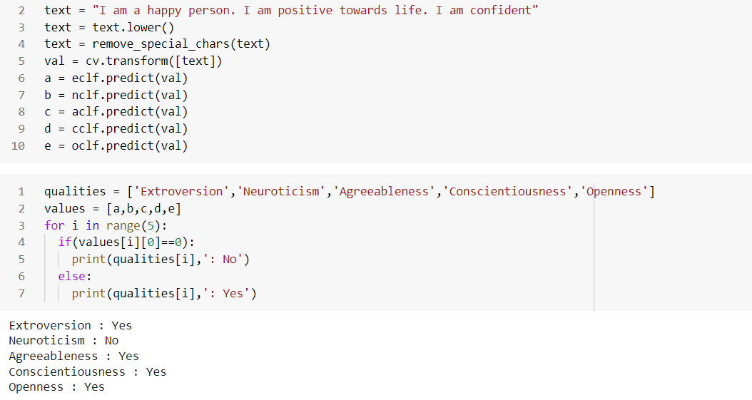
Testing

Slide 17
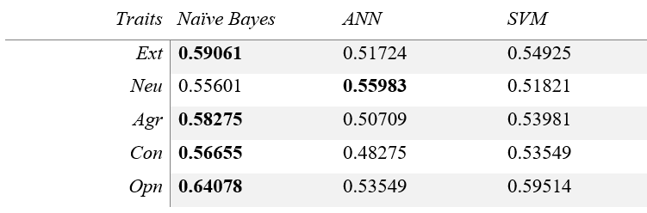
Conclusion
So here we are using both deep learning as well as machine-learning approach where we found almost similar accuracy for both scenarios.
Naïve Bayes is a very simple approach. ANN is the complicated approach. SVM has the simplicity of Naïve Bayes as well as the technicality of ANN.
Sometimes, easy paths are the correct ones and it is always not about taking the tough road. This is exactly what we see here. The simplest Naïve Bayes approach yields a comparatively better accuracy.
Purpose of this whole project was to find an effective solution for prediction of personality and mental health behavior of human beings. And the strategies used, turned out to be quite effective in doing so.

Slide 18

THANK YOU

